Slide 1
Parallel Markov Chain Monte Carlo
Tuan Nguyen & Matthew Gaalswyk
Notes:
30 – 40 slides in total

Slide 2
Outline
Introduction
Markov Chain Monte Carlo (MCMC)
Object Detection
Motivations/Challenges
Parallelizing MCMC using Message Passing Interface (MPI)
Experimental Methodology & Results
Conclusion

Slide 3
Introduction
Monte Carlo method
Markov Chain Monte Carlo
MCMC for Object Detection
Notes:
1 slides for Monte-Carlo; 1 slides for Markov Chain MC; 1 slides for Object Detection; 1 slide

Slide 4

Quiz for fun
Monte Carlo in Monte Carlo method is:
A random name
Name of a scientist
Name of a casino
Name of a city
Name of a famous person
Other
Notes:
1 slides for Monte-Carlo; 1 slides for Markov Chain MC; 1 slides for Object Detection; 1 slide

Slide 5
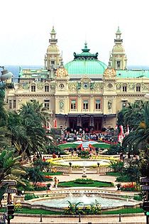
Monte Carlo
Monte Carlo is a casino in Monaco, Italy
Picked by Nicholas Metropolis at Los Alamos Lab (USA) as the code name for their method:
Their idea related to solitaire game
Uncle of a member in team, often borrowed money from relatives to gamble there ☺
Wikipedia

Slide 6
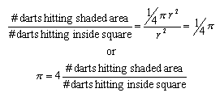
Monte Carlo principle
Given a very large set X and a unknown distribution p(x) over it
We draw i.i.d. a set of N samples
We can then approximate the distribution using these samples
Wikipedia

Slide 7
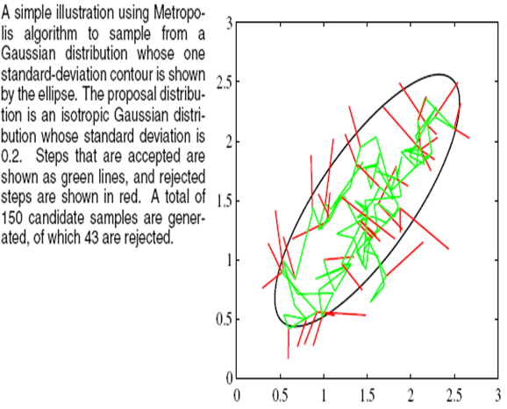
Markov Chain Monte Carlo
Use a “random walk” to draw random samples from p(x)
A proposal function that allows us to move locally based on the previous sample (state)
Samples (moves) are accepted or rejected according to the evaluation result.
[M. Bishop]

Slide 8
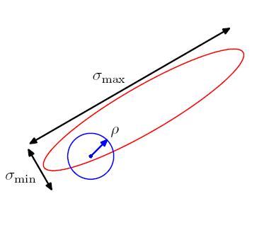
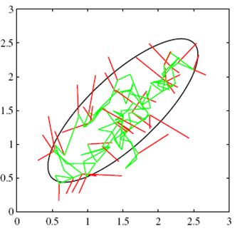
Metropolis Sampling (a MCMC)
A common choice of the proposal is a Gaussian centered on the current state
An important trade-off in determining the variance parameter of this distribution.
Too small
Proportion of accepted transitions with be high,
Progress through the state space takes the form of slow random walk leading to long correlation times.
Too large, then the rejection rate will be high, leading to an inefficient sampling process.

Slide 9
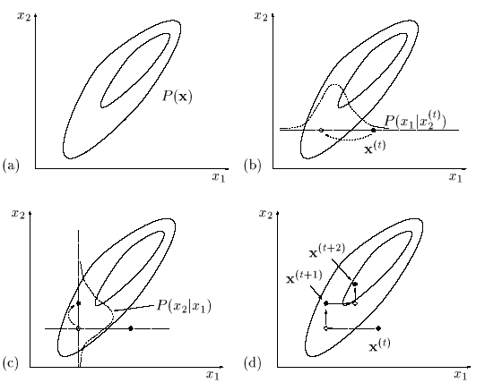
Gibbs Sampling (another MCMC)
What is Gibbs sampling?
It is an algorithm to generate a sequence of samples from the joint probability distribution of two or more random variables.
Why do we need Gibbs sampling?
The purpose is to approximate the joint distribution of multiple variables by sampling each variable individually and sequentially.

Slide 10
MCMC for Object Detection
Given an image with K objects →locate the positions of object
Basic Ideas:
Metropolis Sampling for each object
Use Gibbs Sampling to sample each object individually and sequentially
Likelihood function (Sum Square Error) to accept/reject moves

Slide 11
(Current) Serial MCMC

Slide 12
Motivations/Challenges
Variable
1 2 3 4
Motivation:
MCMC family of algorithms is an important problem in statistical computation
MCMC is usually very time-consuming (Mx10,000 steps)
Most implementations of MCMC is serial MCMC
Challenges:
MCMC is serial in its nature
A lot of randomness involved → Results vary over simulations
Step 1
Step 2
Step 3
Step N

Slide 13

Motivations/Challenges
Question: How to parallelize MCMC (which is serial in its nature) to speed it up but without altering its behavior?

Slide 14
Parallelizing MCMC using MPI
An important trade-off in determining the variance parameter of this distribution.
Too small
Proportion of accepted transitions with be high,
Progress through the state space takes the form of slow random walk leading to long correlation times.
Too large, then the rejection rate will be high, leading to an inefficient sampling process.
2 kinds of trade-off:
Trade-off (adapt) for each unknown distribution
Trade-off for locations in given distribution

Slide 15
Parallelizing MCMC using MPI
Our proposal:
Run several random walks simulation at the same time
Each core uses a different variance
After K iterations, pick the best results, broadcast to all cores
Repeat until convergence

Slide 16
Parallelizing MCMC using MPI
Even more parallelism:

Slide 17
Utilization of MPI
Rank 0 process generates random image and broadcasts
Base Image/disc size
Base Image/disc data
MPI_Bcast
MPI_Bcast(&image_size, 1, MPI_INT, 0, MPI_COMM_WORLD);
MPI_Bcast(&target_size, 1, MPI_INT, 0, MPI_COMM_WORLD);
MPI_Bcast(image, image_size, MPI_DOUBLE, 0, MPI_COMM_WORLD);
MPI_Bcast(target, target_size, MPI_DOUBLE, 0, MPI_COMM_WORLD);

Slide 18
Utilization of MPI
Objective Function result from Gibbs Sampling
MPI_Allreduce
Figure out the best objective function
Rank of owner of the best objective function
MPI_Allreduce( &obj_fn, &result, 1, MPI_DOUBLE_INT, MPI_MAXLOC, MPI_COMM_WORLD );
Broadcast list of points with root being owner of best objective function
MPI_Bcast( &Best_points, num_points*2, MPI_INT, result.rank, MPI_COMM_WORLD );

Slide 19
Experimental Results - Hardware
Run on ECEN servers (moria, gondor, shire)
3 nodes
2x Xeon E5-4617 @ 2.90GHz per node
6 cores per CPU
12 cores per node
36 processes maximum

Slide 20
Experimental Results - Software
Ported MATLAB program to C++
4x speedup initially
Open MPI 1.8.1
Boost 1.41
Primarily for RNG & probability distributions
CImg (Image Processing Toolkit)
Works well for matrix-like operations
Display of results
Saving of image data

Slide 21
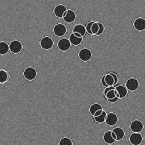
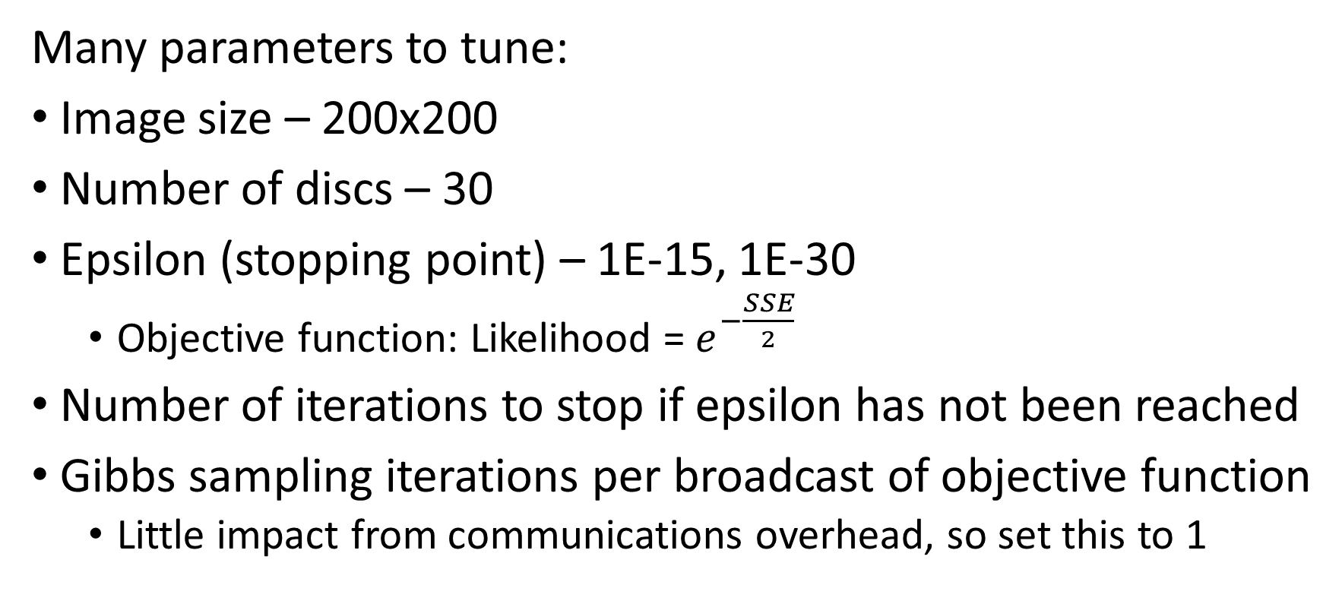
Experimental Results - Methodology
Many parameters to tune:
Image size – 200x200
Number of discs – 30
Epsilon (stopping point) – 1E-15, 1E-30
Objective function: Likelihood = $e^{−\frac{SSE}{2}}$
Number of iterations to stop if epsilon has not been reached
Gibbs sampling iterations per broadcast of objective function
Little impact from communications overhead, so set this to 1

Slide 22
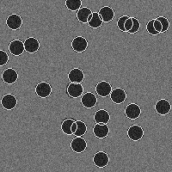
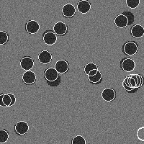
Experimental Results – Objective Function
Epsilon = 1E-15
Epsilon = 1E-30

Slide 23
Experimental Results - Methodology
mpirun -np X (number of programs per process)
5 trials per np with epsilon = 1E-30 (X=1,2,3,6,12,36)
10 trials per np with epsilon = 1E-15 (X=1,3,6,12,24,36)
Default mapping: per socket
-np=3: 1 program per server
-np=36: 12 programs per server
Default binding: per core
Each program binds to one core

Slide 34
Conclusion
Overview of MCMC and an application in Object Detection
Ported serial MCMC MATLAB code to C++
Design parallel MCMC using MPI
Parallelize MCMC for one image
Parallelize MCMC for several image
Implemented on ECEN Servers
Comparison between serial MCMC and parallel MCMC

Slide 35
Thank you!

